Slide 1


Behind the Price Tag: Exploring Smartphone Specs and Pricing on Flipkart

Slide 2
About Us:
I am K. KARTHEEK B.Tech graduate passionate about Data Analytics and Visualization.
LINKEDIN: http://www.linkedin.com/in/kartheek-katari
GITHUB: https://github.com/KartheekKatari
I am P. DHEERAJ LAKSHMAN B.Tech graduate passionate about Data Analytics and Visualization.
LINKEDIN: https://www.linkedin.com/in/dheeraj-lakshman/
GITHUB: https://github.com/DHEERAJPAMU
I am S. VENKATA RAJENDRA REDDY B.Tech graduate passionate about Data Analytics and Visualization.
LINKEDIN: https://www.linkedin.com/in/venkatarajendra/
GITHUB: https://github.com/rajendra9542

Slide 3

Introduction:
Built a web scraping pipeline using Python (Requests, BeautifulSoup) to collect real-time smartphone data.
Product specifications on e-commerce platforms like Flipkart are scattered and unstructured.
Extracted key details — brand, model, price, specifications, and ratings — from Flipkart product listings.
Web scarping helps in collecting real-time mobile data directly from Flipkart.
The scraped data was cleaned, processed, and converted into a structured dataset using Pandas.
Demonstrated data collection automation, ETL (Extract–Transform–Load) skills, and analytical insights using Python.

Slide 4

Business Problem:
Unstructured Data Distribution: Smartphone information is spread across multiple product pages, lacking a centralized or structured format for analysis.
Inconsistent Specifications: Features like RAM, ROM, processor type, and battery capacity are presented inconsistently, making feature comparison difficult.
Dynamic Pricing and Ratings: Frequent updates to prices and user ratings create challenges in maintaining accurate and real-time insights.
Model Variant Confusion: Multiple variants of the same smartphone lead to ambiguity in evaluating true value for money.
Need for Data Analysis: A cleaned, well-structured dataset is essential to enable meaningful comparison, trend analysis, and informed decision-making.

Slide 5

Objectives:
c
Data Extraction: Collect smartphone details — including brand, model, price, RAM, ROM, screen size, battery capacity, and ratings — from Flipkart using web scraping techniques.
Data Cleaning and Structuring: Process and organize the scraped data to transform it into a clean, consistent, and structured dataset suitable for analysis.
Visualization and Insights: Develop visual dashboards and charts to compare features, highlight market positioning, and simplify data-driven decision-making.
.

Slide 6
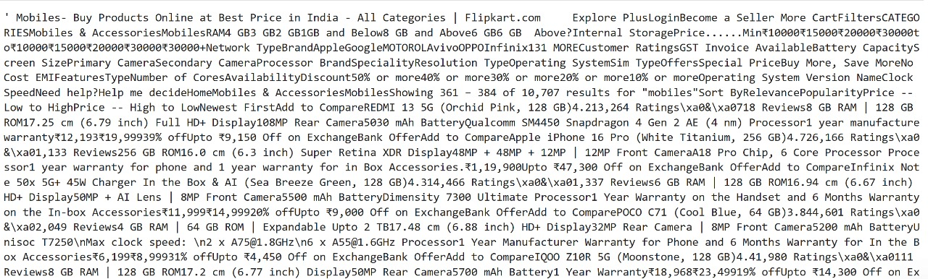
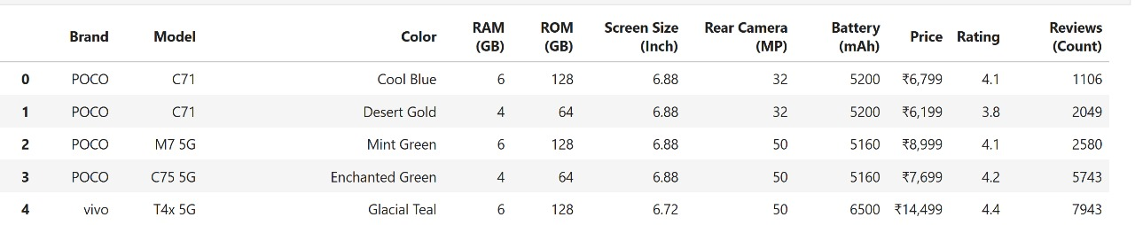
Web Scraping:
Data Source Selection: Flipkart smartphone product pages were chosen as the primary data source for collecting real-time market information across various brands and models.
Web Scraping Implementation: Python libraries Requests and Beautiful Soup were utilized to fetch and parse HTML content efficiently.
Iterative Data Extraction: Product details such as brand, model, price, RAM, ROM, battery, and ratings were extracted across multiple pages and brand categories through iterative scraping loops.
Anti-Blocking Measures: Random time delays were incorporated between requests to simulate human browsing behavior and prevent request blocking
Data Structuring: Extracted information was stored in Python lists and later converted into a Pandas Data Frame, creating a structured dataset ready for cleaning and analysis. .

Slide 7






Libraries Used:

Slide 8
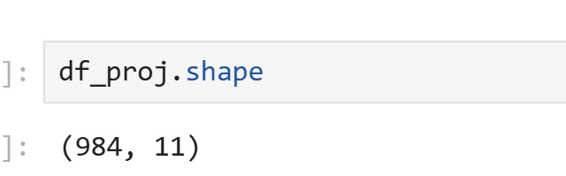
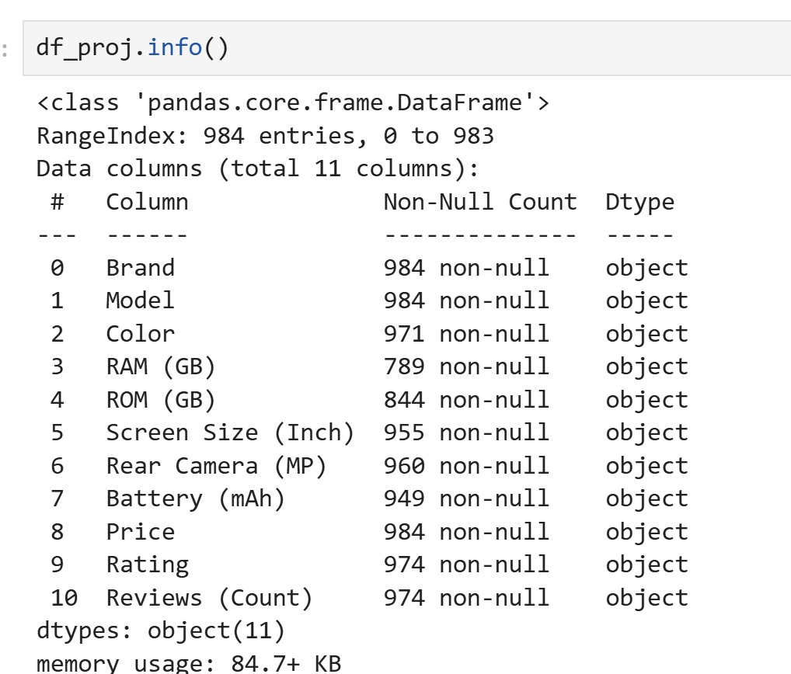
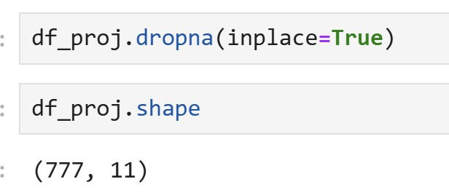
Data Cleaning Steps:
.
Data Type Conversion: Converted price, ratings, and review counts into numeric formats to enable accurate quantitative analysis.
Data Quality Management: Removed null and missing values, eliminated duplicate entries, and verified data integrity for improved accuracy.
Structured Formatting: Organized the cleaned dataset into clearly defined columns within a Pandas Data Frame, ensuring it was ready for analysis and visualization.

Slide 9
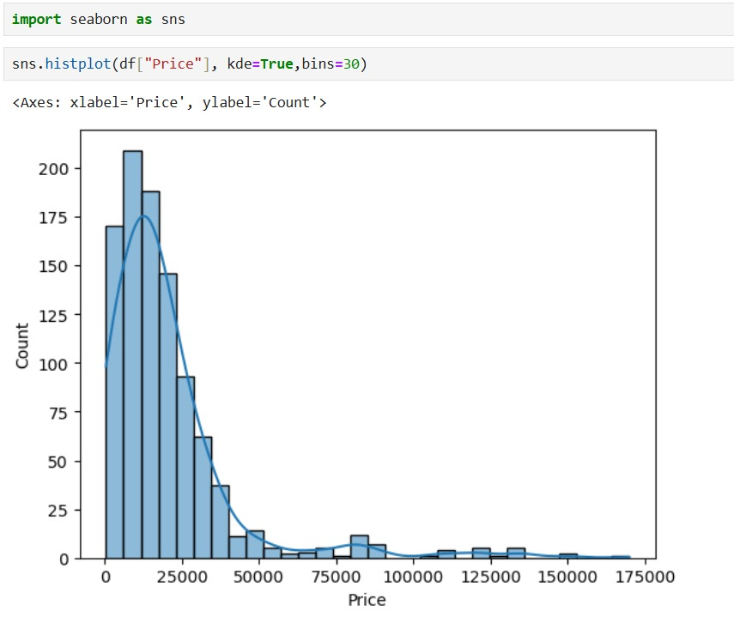
Data Visualization:
Most phones are priced below ₹50,000, as shown by the tallest bars and peak in the KDE curve.
Right-skewed distribution: A long tail stretches toward ₹175,000, indicating a few high-end outliers.
30 bins divide the price range into intervals, giving a detailed view of how prices are spread.

Slide 10
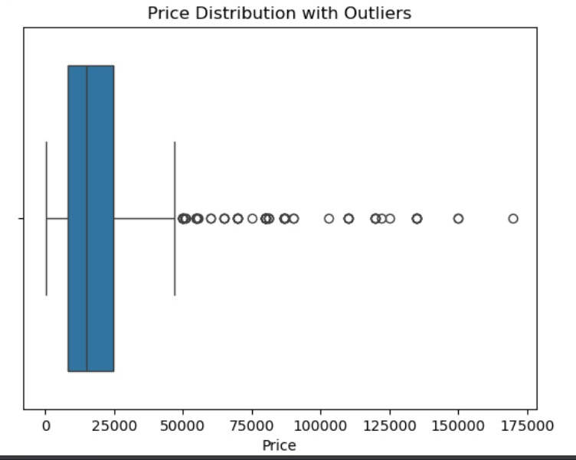
Data Visualization:
The boxplot shows a right-skewed distribution of prices.
Most smartphone prices are clustered below ₹50,000.
There are several outliers above ₹50,000, extending up to around ₹175,000.
This suggests that a few premium models significantly raise the price range.

Slide 11
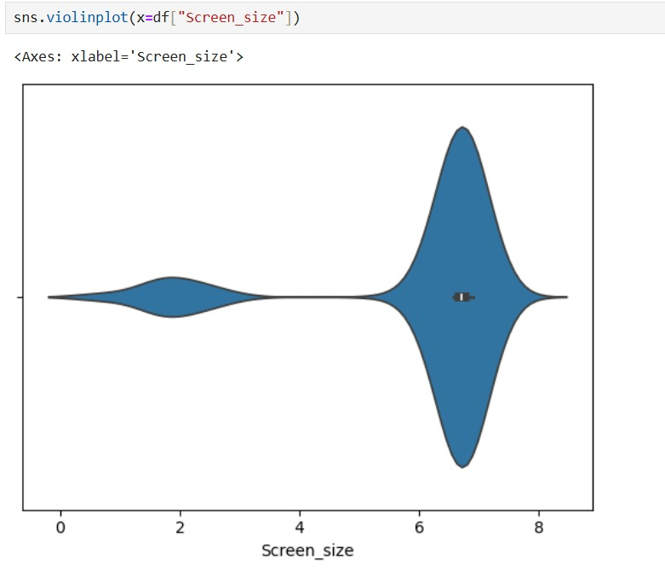
Data Visualization:
The plot shows two major clusters: one around 6–7 inches and another smaller one below 3 inches.
The main bulk of phones are in the 6-inch range, indicating modern smartphone sizes.
The narrow center region suggests less variation around the median.
A few small-screen outliers likely represent older or compact models

Slide 12
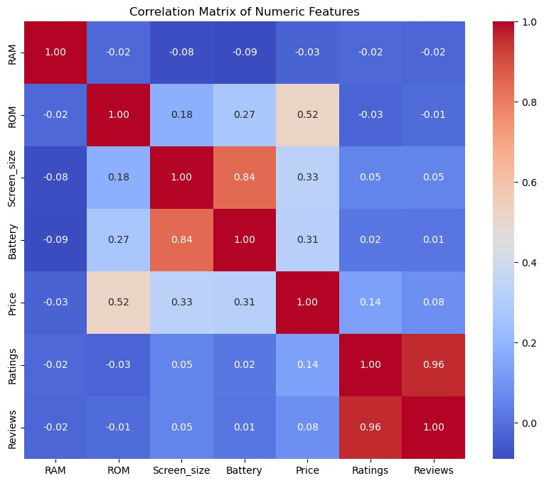
Data Visualization:
Strong correlation (0.84) between Battery and Screen Size, suggesting larger phones have bigger batteries.
ROM and Price (0.52) show moderate correlation — higher storage tends to cost more.
Ratings and Reviews (0.96) are highly correlated, meaning popular phones get both high ratings and more reviews.
Other variables like RAM and Price show very weak correlation (near zero).

Slide 13
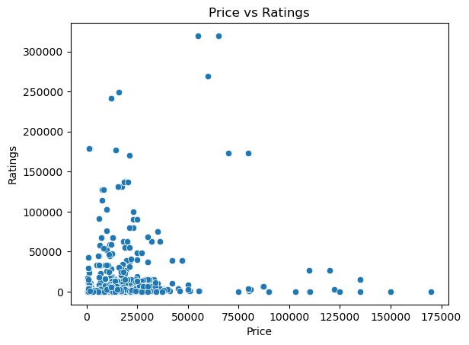
Data Visualization:
Most phones are low- to mid-priced (below ₹50,000) with varying ratings.
A few expensive phones exist, but high price doesn’t necessarily mean high ratings.
Ratings are densely concentrated at lower price levels.
Indicates that affordable models attract more user engagement or reviews.

Slide 14
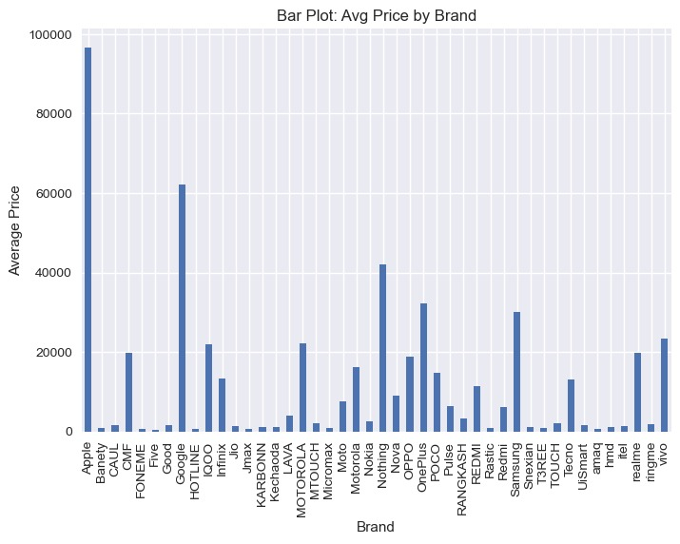
Data Visualization:
Apple dominates the premium segment, with an average price close to ₹100,000 significantly higher than all other brands, indicating strong luxury positioning.
Google ₹60,000 and OnePlus ₹40,000 form the upper-mid tier, suggesting they target performance-conscious buyers without reaching ultra-premium levels.
Over 30 brands cluster below ₹10,000, including Itel, INFINIX, TECNO, and realme.

Slide 15

INSIGHTS
Flipkart’s catalog is dominated by budget smartphones (76%), showing high demand in affordable segments.
Mid-range phones (21%) are steadily growing — preferred by users seeking performance at a reasonable cost.
Premium range (4%) represents niche buyers — driven by brand loyalty and advanced features.
Average smartphone price: ₹20,886, indicating strong consumer preference for value-oriented devices.
Brands like Samsung, Realme, and Vivo together contribute over 50% of all listings, showing their market dominance.

Slide 16

Price differences between brands reflect clear market segmentation Budget Mid Flagship.
Storage & camera specs are key differentiators across all segments.
RAM and battery specs overlap across price levels, leading to price competition in mid-range.
The dataset suggests increasing competition in mid-tier 5G smartphones.
Feature bundling strategy (e.g. high RAM mid camera 5G) is used by brands like iQOO, Realme, and Motorola to attract mid-range buyers.

Slide 17
Conclusion:
Flipkart’s smartphone market is dominated by affordable and mid-range devices, catering to India’s price-sensitive audience.
Storage capacity and brand reputation are the primary price drivers.
Consumers prefer high-rated, affordable smartphones over premium but less-reviewed ones.
The average consumer expectation: large display, strong battery, good camera, 5G, and value-for-money pricing.
EDA results can support pricing strategy, marketing focus, and stock optimization for e-commerce businesses.

Slide 18
Experience– Web Scraping & Data Analysis:
Scraped phones from Flipkart data using Python (BeautifulSoup, pandas).
Cleaned and Analysis data on (prize , brand, Rating) columns.
Created visualizations showing prize category , Rating
Learned end-to-end data workflow: scraping → cleaning → analysis → visualization.

Slide 19
Challenges – Web Scraping & Data Analysis:
Inconsistent webpage structures across Brands.
Missing or mismatched match details.
Handling duplicate and unclean data.
Overcoming request blocks and slow scraping.
Choosing the most meaningful visuals for insights.

Slide 20


